Slide 1
N Queen Problem
Presented By:
Shaykh Siddique
Moname Majumder
Anika Tabassum
Department of Computer Science and Engineering
East West University.

Slide 2
Overview
Introduction
What is N Queen problem
Basic Requirements
Applications
Use of N Queen problem
Algorithm
Pseudocode
How does it works (simulation)
Conclusions

Slide 3
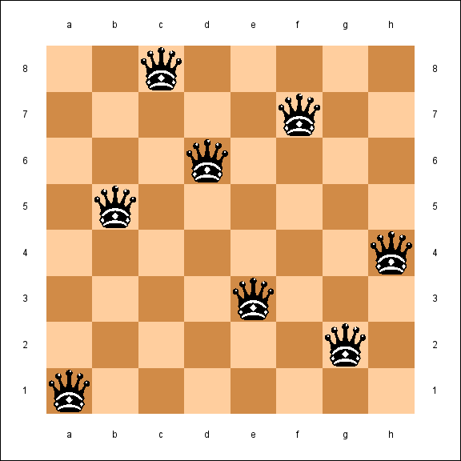
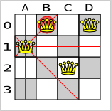
Problem Definition
The N Queen is the problem of placing N chess queens on an N×N chessboard so that no two queens attack each other.
Queen can attack on the same row , same column or diagonally.
Queen’s attacking line
Wrong placement of Queen

Slide 4
Problem Definition
The N Queen is the problem of placing N chess queens on an N×N chessboard so that no two queens attack each other.
Queen can attack on the same row , same column or diagonally.
There could be many valid ways to fill a N×N chessboard.
8 × 8 Chessboard

Slide 5
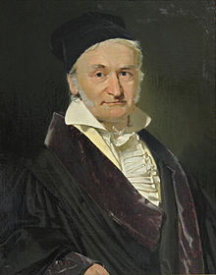
Problem Definition
The n-queens problem, originally introduced in 1850 by Carl Gauss, may be stated as follows: find a placement of n queens on an N×N chessboard, such that no one queen can be taken by any other.
Johann Carl Friedrich Gauss
Johann Carl Friedrich Gauss (1777-1855) was a German mathematician who contributed significantly to many fields, including number theory, algebra, statistics, analysis, differential geometry, geodesy, geophysics, mechanics, electrostatics, magnetic fields, astronomy, matrix theory, and optics.

Slide 6
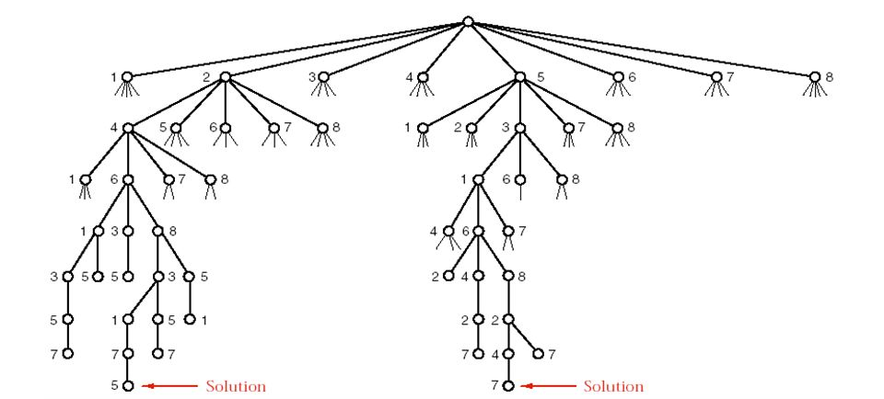
Basic Requirements
Part of the recursion tree for the N Queen Problem

Slide 7
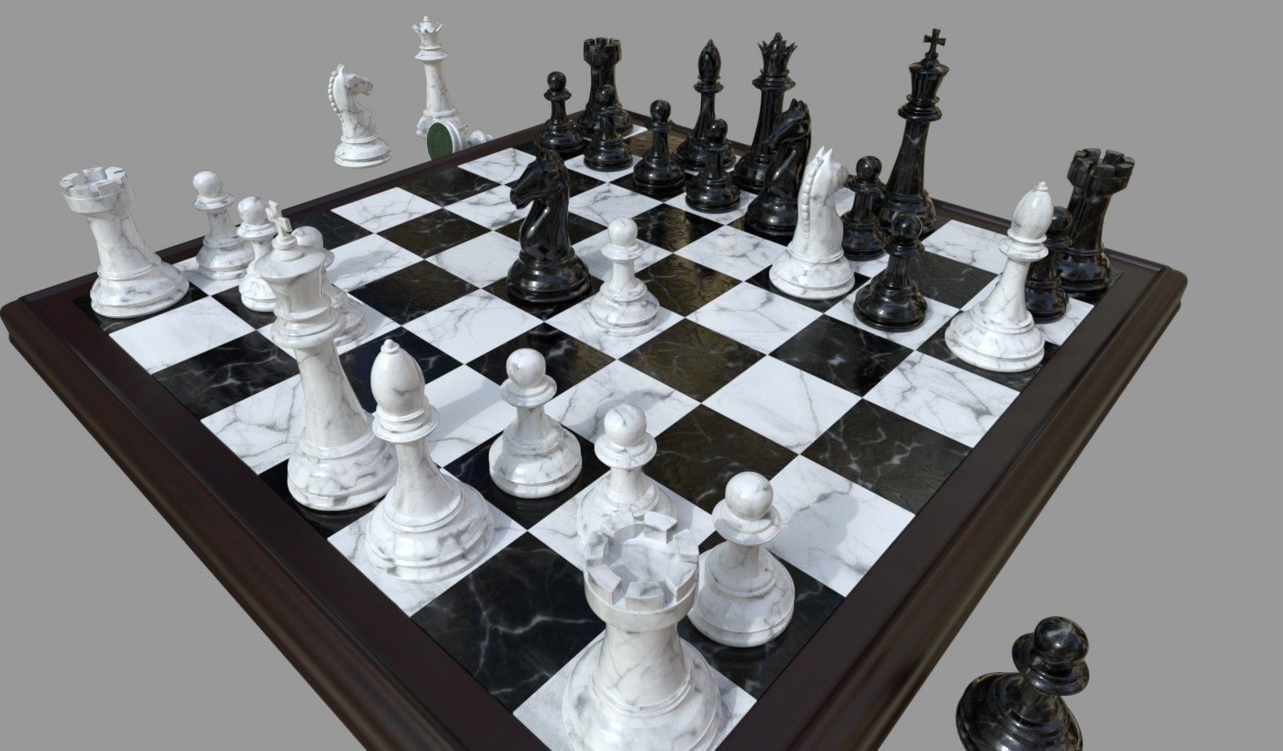
Applications
Board Game

Slide 8
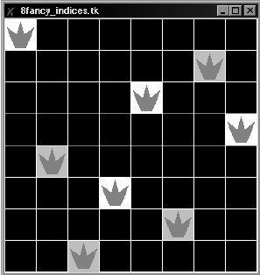
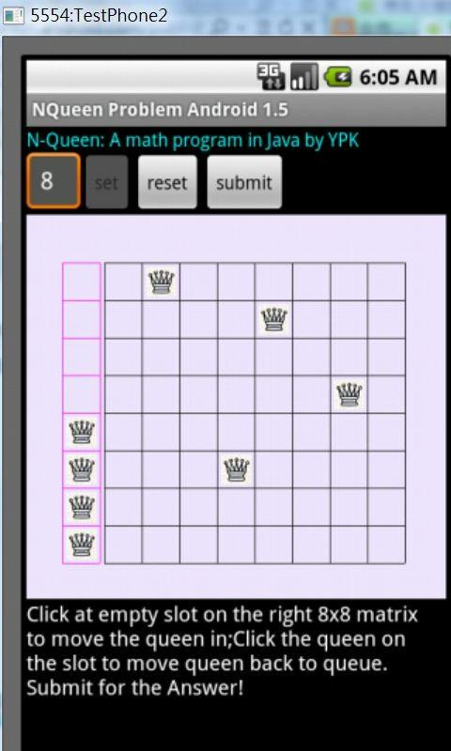
Applications
Board Game.
Applying in Game Developing.

Slide 9
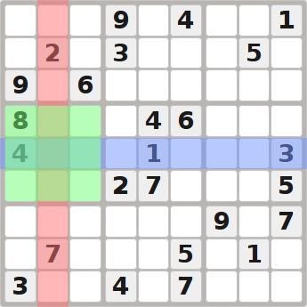
Applications
Board Game.
Applying in Game Developing.
Sudoku Solving.

Slide 10
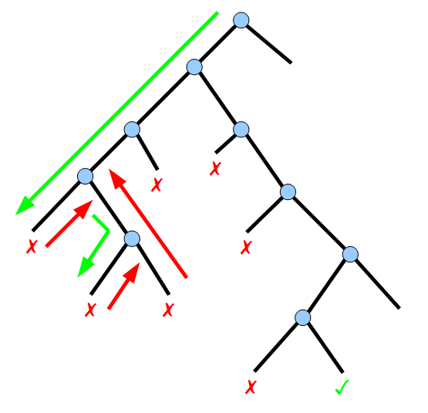
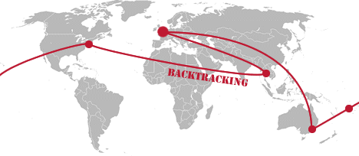
Applications
Board Game.
Applying in Game Developing.
Sudoku Solving.
A perfect example of backtracking problem.

Slide 11
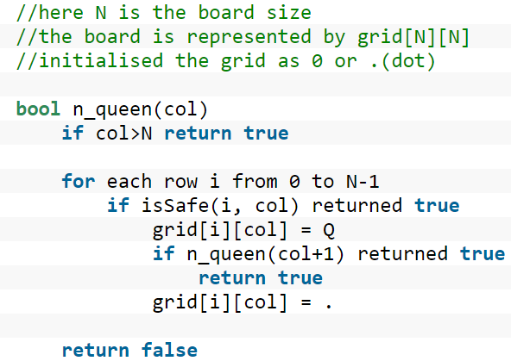
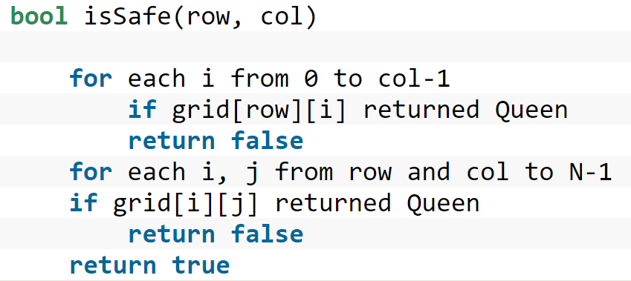
Algorithm
Pseudocode

Slide 12
N Queens
Simulation of 4×4 chessboard
Check validity of position (0, 0)
Columns | 0 | 1 | 2 | 3
r/c | 0 | 1 | 2 | 3
0 | 0 | 0 | 0 | 0
1 | 0 | 0 | 0 | 0
2 | 0 | 0 | 0 | 0
3 | 0 | 0 | 0 | 0
Safe movement
Rows | 0 | 1 | 2 | 3

Slide 13
N Queens
Simulation of 4×4 chessboard
Move a queen to (0, 0)
Columns | 0 | 1 | 2 | 3
r/c | 0 | 1 | 2 | 3
0 | 1 | 0 | 0 | 0
1 | 0 | 0 | 0 | 0
2 | 0 | 0 | 0 | 0
3 | 0 | 0 | 0 | 0
Rows | 0 | 1 | 2 | 3

Slide 14
N Queens
Simulation of 4×4 chessboard
Check validity of position (0, 1).
Columns | 0 | 1 | 2 | 3
r/c | 0 | 1 | 2 | 3
0 | 1 | 0 | 0 | 0
1 | 0 | 0 | 0 | 0
2 | 0 | 0 | 0 | 0
3 | 0 | 0 | 0 | 0
Not safe movement
Rows | 0 | 1 | 2 | 3

Slide 15
N Queens
Simulation of 4×4 chessboard
Check validity of position (1, 1).
Columns | 0 | 1 | 2 | 3
r/c | 0 | 1 | 2 | 3
0 | 1 | 0 | 0 | 0
1 | 0 | 0 | 0 | 0
2 | 0 | 0 | 0 | 0
3 | 0 | 0 | 0 | 0
Not safe movement
Rows | 0 | 1 | 2 | 3

Slide 16
N Queens
Simulation of 4×4 chessboard
Check validity of position (2, 1).
Columns | 0 | 1 | 2 | 3
r/c | 0 | 1 | 2 | 3
0 | 1 | 0 | 0 | 0
1 | 0 | 0 | 0 | 0
2 | 0 | 0 | 0 | 0
3 | 0 | 0 | 0 | 0
Safe movement
Rows | 0 | 1 | 2 | 3

Slide 17
N Queens
Simulation of 4×4 chessboard
Move a queen to (2, 1)
Columns | 0 | 1 | 2 | 3
r/c | 0 | 1 | 2 | 3
0 | 1 | 0 | 0 | 0
1 | 0 | 0 | 0 | 0
2 | 0 | 1 | 0 | 0
3 | 0 | 0 | 0 | 0
Rows | 0 | 1 | 2 | 3

Slide 18
N Queens
Simulation of 4×4 chessboard
Check validity of position (0, 2).
Columns | 0 | 1 | 2 | 3
r/c | 0 | 1 | 2 | 3
0 | 1 | 0 | 0 | 0
1 | 0 | 0 | 0 | 0
2 | 0 | 1 | 0 | 0
3 | 0 | 0 | 0 | 0
Not safe movement
Rows | 0 | 1 | 2 | 3

Slide 19
N Queens
Simulation of 4×4 chessboard
Check validity of position (1, 2).
Columns | 0 | 1 | 2 | 3
r/c | 0 | 1 | 2 | 3
0 | 1 | 0 | 0 | 0
1 | 0 | 0 | 0 | 0
2 | 0 | 1 | 0 | 0
3 | 0 | 0 | 0 | 0
Not safe movement
Rows | 0 | 1 | 2 | 3

Slide 20
N Queens
Simulation of 4×4 chessboard
Check validity of position (2, 2).
Columns | 0 | 1 | 2 | 3
r/c | 0 | 1 | 2 | 3
0 | 1 | 0 | 0 | 0
1 | 0 | 0 | 0 | 0
2 | 0 | 1 | 0 | 0
3 | 0 | 0 | 0 | 0
Not safe movement
Rows | 0 | 1 | 2 | 3

Slide 21
N Queens
Simulation of 4×4 chessboard
Check validity of position (3, 2).
Columns | 0 | 1 | 2 | 3
r/c | 0 | 1 | 2 | 3
0 | 1 | 0 | 0 | 0
1 | 0 | 0 | 0 | 0
2 | 0 | 1 | 0 | 0
3 | 0 | 0 | 0 | 0
Rows | 0 | 1 | 2 | 3
Not safe movement

Slide 22
N Queens
Simulation of 4×4 chessboard
Columns | 0 | 1 | 2 | 3
r/c | 0 | 1 | 2 | 3
0 | 1 | 0 | 0 | 0
1 | 0 | 0 | 0 | 0
2 | 0 | 1 | 0 | 0
3 | 0 | 0 | 0 | 0
Rows | 0 | 1 | 2 | 3
Function cannot move a Queen for this column.
So it will return by backtracking.

Slide 23
N Queens
Simulation of 4×4 chessboard
Return to position (0, 2).
Columns | 0 | 1 | 2 | 3
r/c | 0 | 1 | 2 | 3
0 | 1 | 0 | 0 | 0
1 | 0 | 0 | 0 | 0
2 | 0 | 1 | 0 | 0
3 | 0 | 0 | 0 | 0
Not efficient movement.
Remove this queen.
Rows | 0 | 1 | 2 | 3

Slide 24
N Queens
Simulation of 4×4 chessboard
Check validity of position (3, 1).
Columns | 0 | 1 | 2 | 3
r/c | 0 | 1 | 2 | 3
0 | 1 | 0 | 0 | 0
1 | 0 | 0 | 0 | 0
2 | 0 | 0 | 0 | 0
3 | 0 | 0 | 0 | 0
Rows | 0 | 1 | 2 | 3
Safe movement

Slide 25
N Queens
Simulation of 4×4 chessboard
Move a queen to (3, 1)
Columns | 0 | 1 | 2 | 3
r/c | 0 | 1 | 2 | 3
0 | 1 | 0 | 0 | 0
1 | 0 | 0 | 0 | 0
2 | 0 | 0 | 0 | 0
3 | 0 | 1 | 0 | 0
Rows | 0 | 1 | 2 | 3

Slide 26
N Queens
Simulation of 4×4 chessboard
Check validity of position(0, 2)
Columns | 0 | 1 | 2 | 3
r/c | 0 | 1 | 2 | 3
0 | 1 | 0 | 0 | 0
1 | 0 | 0 | 0 | 0
2 | 0 | 0 | 0 | 0
3 | 0 | 1 | 0 | 0
Not safe movement
Rows | 0 | 1 | 2 | 3

Slide 27
N Queens
Simulation of 4×4 chessboard
Check validity of position(1, 2)
Columns | 0 | 1 | 2 | 3
r/c | 0 | 1 | 2 | 3
0 | 1 | 0 | 0 | 0
1 | 0 | 0 | 0 | 0
2 | 0 | 0 | 0 | 0
3 | 0 | 1 | 0 | 0
Safe movement
Rows | 0 | 1 | 2 | 3

Slide 28
N Queens
Simulation of 4×4 chessboard
Move a queen to (1, 2)
Columns | 0 | 1 | 2 | 3
r/c | 0 | 1 | 2 | 3
0 | 1 | 0 | 0 | 0
1 | 0 | 0 | 1 | 0
2 | 0 | 0 | 0 | 0
3 | 0 | 1 | 0 | 0
Rows | 0 | 1 | 2 | 3

Slide 29
N Queens
Simulation of 4×4 chessboard
Check validity of position(0, 3)
Columns | 0 | 1 | 2 | 3
r/c | 0 | 1 | 2 | 3
0 | 1 | 0 | 0 | 0
1 | 0 | 0 | 1 | 0
2 | 0 | 0 | 0 | 0
3 | 0 | 1 | 0 | 0
Not safe movement
Rows | 0 | 1 | 2 | 3

Slide 30
N Queens
Simulation of 4×4 chessboard
Check validity of position(1, 3)
Columns | 0 | 1 | 2 | 3
r/c | 0 | 1 | 2 | 3
0 | 1 | 0 | 0 | 0
1 | 0 | 0 | 1 | 0
2 | 0 | 0 | 0 | 0
3 | 0 | 1 | 0 | 0
Not safe movement
Rows | 0 | 1 | 2 | 3

Slide 31
N Queens
Simulation of 4×4 chessboard
Check validity of position(2, 3)
Columns | 0 | 1 | 2 | 3
r/c | 0 | 1 | 2 | 3
0 | 1 | 0 | 0 | 0
1 | 0 | 0 | 1 | 0
2 | 0 | 0 | 0 | 0
3 | 0 | 1 | 0 | 0
Not safe movement
Rows | 0 | 1 | 2 | 3

Slide 32
N Queens
Simulation of 4×4 chessboard
Check validity of position(3, 3)
Columns | 0 | 1 | 2 | 3
r/c | 0 | 1 | 2 | 3
0 | 1 | 0 | 0 | 0
1 | 0 | 0 | 1 | 0
2 | 0 | 0 | 0 | 0
3 | 0 | 1 | 0 | 0
Rows | 0 | 1 | 2 | 3
Not safe movement

Slide 33
N Queens
Simulation of 4×4 chessboard
Columns | 0 | 1 | 2 | 3
r/c | 0 | 1 | 2 | 3
0 | 1 | 0 | 0 | 0
1 | 0 | 0 | 1 | 0
2 | 0 | 0 | 0 | 0
3 | 0 | 1 | 0 | 0
Rows | 0 | 1 | 2 | 3
Function cannot move a Queen for this column.
So it will return by backtracking.

Slide 34
N Queens
Simulation of 4×4 chessboard
Return to position (1, 2).
Columns | 0 | 1 | 2 | 3
r/c | 0 | 1 | 2 | 3
0 | 1 | 0 | 0 | 0
1 | 0 | 0 | 1 | 0
2 | 0 | 0 | 0 | 0
3 | 0 | 1 | 0 | 0
Not efficient movement.
Remove this queen.
Rows | 0 | 1 | 2 | 3

Slide 35
N Queens
Simulation of 4×4 chessboard
Check validity of position(2, 2)
Columns | 0 | 1 | 2 | 3
r/c | 0 | 1 | 2 | 3
0 | 1 | 0 | 0 | 0
1 | 0 | 0 | 0 | 0
2 | 0 | 0 | 0 | 0
3 | 0 | 1 | 0 | 0
Not safe movement
Rows | 0 | 1 | 2 | 3

Slide 36
N Queens
Simulation of 4×4 chessboard
Check validity of position(3, 2)
Columns | 0 | 1 | 2 | 3
r/c | 0 | 1 | 2 | 3
0 | 1 | 0 | 0 | 0
1 | 0 | 0 | 0 | 0
2 | 0 | 0 | 0 | 0
3 | 0 | 1 | 0 | 0
Rows | 0 | 1 | 2 | 3
Not safe movement

Slide 37
N Queens
Simulation of 4×4 chessboard
Columns | 0 | 1 | 2 | 3
r/c | 0 | 1 | 2 | 3
0 | 1 | 0 | 0 | 0
1 | 0 | 0 | 0 | 0
2 | 0 | 0 | 0 | 0
3 | 0 | 1 | 0 | 0
Rows | 0 | 1 | 2 | 3
Function cannot move a Queen for this column.
So it will return by backtracking.

Slide 38
N Queens
Simulation of 4×4 chessboard
Return to position (3, 1).
Columns | 0 | 1 | 2 | 3
r/c | 0 | 1 | 2 | 3
0 | 1 | 0 | 0 | 0
1 | 0 | 0 | 0 | 0
2 | 0 | 0 | 0 | 0
3 | 0 | 1 | 0 | 0
Not efficient movement.
Remove this queen.
Rows | 0 | 1 | 2 | 3

Slide 39
N Queens
Simulation of 4×4 chessboard
Columns | 0 | 1 | 2 | 3
r/c | 0 | 1 | 2 | 3
0 | 1 | 0 | 0 | 0
1 | 0 | 0 | 0 | 0
2 | 0 | 0 | 0 | 0
3 | 0 | 0 | 0 | 0
Rows | 0 | 1 | 2 | 3
Function cannot move a Queen for this column.
So it will return by backtracking.

Slide 40
N Queens
Simulation of 4×4 chessboard
Return to position (0, 0).
Columns | 0 | 1 | 2 | 3
r/c | 0 | 1 | 2 | 3
0 | 1 | 0 | 0 | 0
1 | 0 | 0 | 0 | 0
2 | 0 | 0 | 0 | 0
3 | 0 | 0 | 0 | 0
Not efficient movement.
Remove this queen.
Rows | 0 | 1 | 2 | 3

Slide 41
N Queens
Simulation of 4×4 chessboard
Check validity of position (1, 0)
Columns | 0 | 1 | 2 | 3
r/c | 0 | 1 | 2 | 3
0 | 0 | 0 | 0 | 0
1 | 0 | 0 | 0 | 0
2 | 0 | 0 | 0 | 0
3 | 0 | 0 | 0 | 0
Safe movement
Rows | 0 | 1 | 2 | 3

Slide 42
N Queens
Simulation of 4×4 chessboard
Check validity of position (0, 1)
Columns | 0 | 1 | 2 | 3
r/c | 0 | 1 | 2 | 3
0 | 0 | 0 | 0 | 0
1 | 1 | 0 | 0 | 0
2 | 0 | 0 | 0 | 0
3 | 0 | 0 | 0 | 0
Not safe movement
Rows | 0 | 1 | 2 | 3

Slide 43
N Queens
Simulation of 4×4 chessboard
Check validity of position (1, 1)
Columns | 0 | 1 | 2 | 3
r/c | 0 | 1 | 2 | 3
0 | 0 | 0 | 0 | 0
1 | 1 | 0 | 0 | 0
2 | 0 | 0 | 0 | 0
3 | 0 | 0 | 0 | 0
Not safe movement
Rows | 0 | 1 | 2 | 3

Slide 44
N Queens
Simulation of 4×4 chessboard
Check validity of position (2, 1)
Columns | 0 | 1 | 2 | 3
r/c | 0 | 1 | 2 | 3
0 | 0 | 0 | 0 | 0
1 | 1 | 0 | 0 | 0
2 | 0 | 0 | 0 | 0
3 | 0 | 0 | 0 | 0
Not safe movement
Rows | 0 | 1 | 2 | 3

Slide 45
N Queens
Simulation of 4×4 chessboard
Check validity of position (3, 1)
Columns | 0 | 1 | 2 | 3
r/c | 0 | 1 | 2 | 3
0 | 0 | 0 | 0 | 0
1 | 1 | 0 | 0 | 0
2 | 0 | 0 | 0 | 0
3 | 0 | 0 | 0 | 0
Rows | 0 | 1 | 2 | 3
Safe movement

Slide 46
N Queens
Simulation of 4×4 chessboard
Check validity of position (0, 2)
Columns | 0 | 1 | 2 | 3
r/c | 0 | 1 | 2 | 3
0 | 0 | 0 | 0 | 0
1 | 1 | 0 | 0 | 0
2 | 0 | 0 | 0 | 0
3 | 0 | 1 | 0 | 0
Safe movement
Rows | 0 | 1 | 2 | 3

Slide 47
N Queens
Simulation of 4×4 chessboard
Move a queen to (0, 2)
Columns | 0 | 1 | 2 | 3
r/c | 0 | 1 | 2 | 3
0 | 0 | 0 | 1 | 0
1 | 1 | 0 | 0 | 0
2 | 0 | 0 | 0 | 0
3 | 0 | 1 | 0 | 0
Rows | 0 | 1 | 2 | 3

Slide 48
N Queens
Simulation of 4×4 chessboard
Check validity of position (0, 3)
Columns | 0 | 1 | 2 | 3
r/c | 0 | 1 | 2 | 3
0 | 0 | 0 | 1 | 0
1 | 1 | 0 | 0 | 0
2 | 0 | 0 | 0 | 0
3 | 0 | 1 | 0 | 0
Not safe movement
Rows | 0 | 1 | 2 | 3

Slide 49
N Queens
Simulation of 4×4 chessboard
Check validity of position (1, 3)
Columns | 0 | 1 | 2 | 3
r/c | 0 | 1 | 2 | 3
0 | 0 | 0 | 1 | 0
1 | 1 | 0 | 0 | 0
2 | 0 | 0 | 0 | 0
3 | 0 | 1 | 0 | 0
Not safe movement
Rows | 0 | 1 | 2 | 3

Slide 50
N Queens
Simulation of 4×4 chessboard
Check validity of position (1, 3)
Columns | 0 | 1 | 2 | 3
r/c | 0 | 1 | 2 | 3
0 | 0 | 0 | 1 | 0
1 | 1 | 0 | 0 | 0
2 | 0 | 0 | 0 | 0
3 | 0 | 1 | 0 | 0
Safe movement
Rows | 0 | 1 | 2 | 3

Slide 51
N Queens
Simulation of 4×4 chessboard
Move a queen to (0, 2)
Columns | 0 | 1 | 2 | 3
r/c | 0 | 1 | 2 | 3
0 | 0 | 0 | 1 | 0
1 | 1 | 0 | 0 | 0
2 | 0 | 0 | 0 | 1
3 | 0 | 1 | 0 | 0
Rows | 0 | 1 | 2 | 3

